Slide 1




PDS
slido.com
Computer Vision
https://github.com/siagianp
https://www.youtube.com/@AmelOline/videos
https://github.com/amelcharolinesgn2/Cloud-Infrastructures
https://github.com/amelcharolinesgn2/ClouD-Infrastructure-SISKA-2025
https://github.com/amelcharolinesgn2/CCNA1
https://github.com/amelcharolinesgn2/CCNA2
https://github.com/amelcharolinesgn2/AWS Certificate
Notes:
Lab Session 01: AWS Compute Foundations – EC2, Networking, and Application Deployment Lab Session 02: Identity and Access Control with IAM Lab Session 03: Cloud Storage Solutions – S3, EBS, and EFS Lab Session 04: Database Services – RDS, DynamoDB, and ElastiCache Lab Session 05: Load Balancing and Auto Scaling Lab Session 06: Container Orchestration with ECS, Fargate, and EKS Lab Session 07: Serverless Computing with Lambda Lab Session 08: Monitoring, Logging, and Security Auditing Lab Session 09: Infrastructure as Code – CloudFormation, CDK, and Terraform Lab Session 10: CI/CD Pipelines – App Runner, CodePipeline, GitHub Actions, and CodeDeploy Lab Session 11: AI/ML Services – Rekognition, Comprehend, Translate, and SageMaker Lab Session 12: Hybrid Cloud Networking – VPC Peering, Transit Gateway, VPN, and Direct Connect Lab Session 13: Security and Compliance – AWS Config, GuardDuty, Security Hub, and KMS Lab Session 14: Disaster Recovery and Business Continuity – AWS Backup, Multi-Region, and Failover Lab Session 15: Migration and Modernization – DataSync, DMS, MGN, Containers, and Serverless
Lab Session 16: Cost Management and Optimization – Cost Explorer, Trusted Advisor, Budgets, and Well-Architected
https://www.youtube.com/watch?v=SOTamWNgDKc&t=19604s

Slide 2

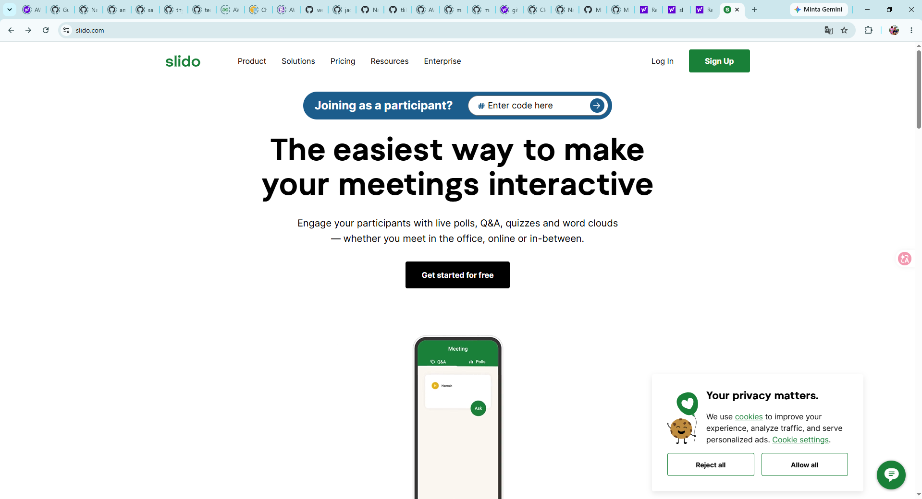


Do not edit
How to change the design
slido.com
Presenting with animations, GIFs or speaker notes? Enable our Chrome extension
Notes:
📣 This is Slido interaction slide, please don't delete it.
✅ Click on 'Present with Slido' and the joining instructions will appear when you get to this slide.

Slide 3

Do not edit
How to change the design
How many hours have you been code?
Presenting with animations, GIFs or speaker notes? Enable our Chrome extension
Notes:
📣 This is Slido interaction slide, please don't delete it.
✅ Click on 'Present with Slido' and the poll will launch automatically when you get to this slide.

Slide 4
Do not edit
How to change the design
What is your expected salary?
Presenting with animations, GIFs or speaker notes? Enable our Chrome extension
Notes:
📣 This is Slido interaction slide, please don't delete it.
✅ Click on 'Present with Slido' and the poll will launch automatically when you get to this slide.

Slide 5

Do not edit
How to change the design
Why do we need CI CD?
Presenting with animations, GIFs or speaker notes? Enable our Chrome extension
Notes:
📣 This is Slido interaction slide, please don't delete it.
✅ Click on 'Present with Slido' and the poll will launch automatically when you get to this slide.

Slide 6
Serverless Computing with AWS Lambda
Run applications without managing Infrastructure

Slide 7

What is Serverless Computing?
Serverless computing allows you to build and run applications without managing servers.
The cloud provider handles the infrastructure, scaling, and maintenance.
Benefits: Reduced operational cost, automatic scaling, and faster time to market.

Slide 8

Do not edit
How to change the design
What is the main advantage of serverless computing?
Presenting with animations, GIFs or speaker notes? Enable our Chrome extension
Notes:
📣 This is Slido interaction slide, please don't delete it.
✅ Click on 'Present with Slido' and the poll will launch automatically when you get to this slide.

Slide 9
Key Characteristics of Serverless
No server management
Flexible scaling
Pay-as-you-go pricing
High availability and fault tolerance

Slide 10
Do not edit
How to change the design
Which of the following is NOT a characteristic of serverless computing?
Presenting with animations, GIFs or speaker notes? Enable our Chrome extension
Notes:
📣 This is Slido interaction slide, please don't delete it.
✅ Click on 'Present with Slido' and the poll will launch automatically when you get to this slide.

Slide 11
Q1
What is the primary characteristic of serverless computing?
No servers are used at all
Developers manage the infrastructure manually
Automatic scaling and event-driven execution
It only supports AWS services

Slide 12
Q1 Answer
What is the primary characteristic of serverless computing?
No servers are used at all
Developers manage the infrastructure manually
Automatic scaling and event-driven execution (Correct)
It only supports AWS services

Slide 13

What is AWS Lambda?
AWS Lambda is a compute service that runs code without provisioning or managing servers.
Functions execute automatically in response to events. (like image upload)
Supported languages include Python, Node.js, Java, Go, Ruby, and C#.

Slide 14
Do not edit
How to change the design
AWS Lambda runs code in response to:
Presenting with animations, GIFs or speaker notes? Enable our Chrome extension
Notes:
📣 This is Slido interaction slide, please don't delete it.
✅ Click on 'Present with Slido' and the poll will launch automatically when you get to this slide.

Slide 15
How AWS Lambda Works
Developer writes a function and deploys it.
An event (such as an API call, S3 file upload) triggers the function.
Lambda executes the function in an isolated environment.
The function runs and then scales automatically based on demand.

Slide 16
Do not edit
How to change the design
Which service can trigger AWS Lambda?
Presenting with animations, GIFs or speaker notes? Enable our Chrome extension
Notes:
📣 This is Slido interaction slide, please don't delete it.
✅ Click on 'Present with Slido' and the poll will launch automatically when you get to this slide.

Slide 17
AWS Lambda Use Cases
Real-time file processing (e.g., image or video uploads)
Data transformation and ETL (Extract, transform, and load) workflows
Backend for web and mobile applications
IoT backends and automated backups

Slide 18
Do not edit
How to change the design
Which is NOT a common use case for AWS Lambda?
Presenting with animations, GIFs or speaker notes? Enable our Chrome extension
Notes:
📣 This is Slido interaction slide, please don't delete it.
✅ Click on 'Present with Slido' and the poll will launch automatically when you get to this slide.

Slide 19
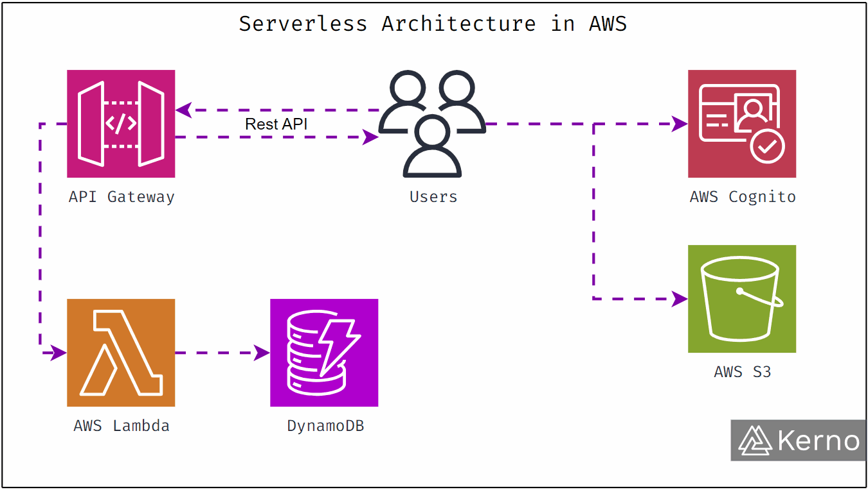
Serverless Architecture with AWS Lambda
AWS Lambda integrates with API Gateway for RESTful APIs.
DynamoDB for data storage.
Amazon S3 for object storage.
Amazon SNS for notifications.

Slide 20
Do not edit
How to change the design
Which service is commonly used with AWS Lambda for data storage?
Presenting with animations, GIFs or speaker notes? Enable our Chrome extension
Notes:
📣 This is Slido interaction slide, please don't delete it.
✅ Click on 'Present with Slido' and the poll will launch automatically when you get to this slide.

Slide 21
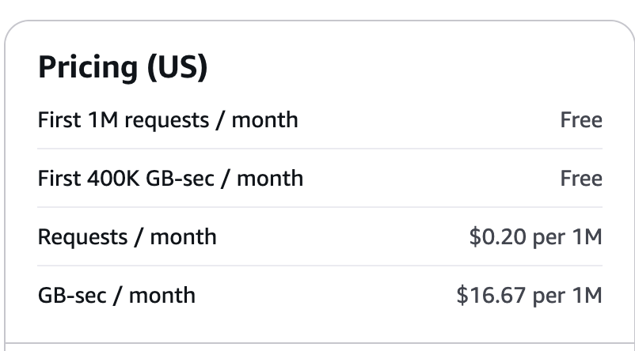
AWS Lambda Pricing
Pricing is based on the number of requests and duration of code execution.
First 1M requests per month are free.
Duration is calculated from code execution start to end.

Slide 22
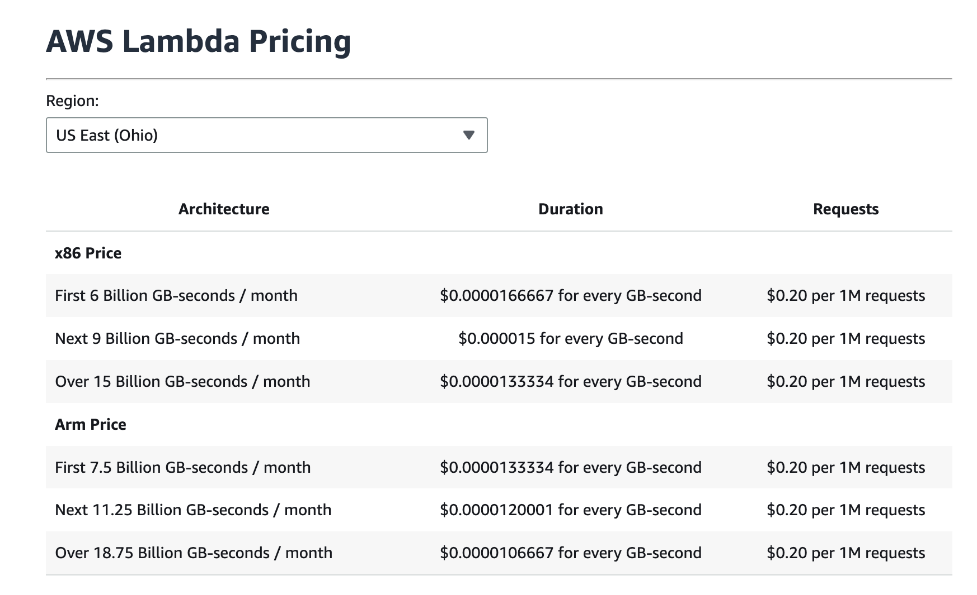

Slide 23
Do not edit
How to change the design
AWS Lambda pricing depends on:
Presenting with animations, GIFs or speaker notes? Enable our Chrome extension
Notes:
📣 This is Slido interaction slide, please don't delete it.
✅ Click on 'Present with Slido' and the poll will launch automatically when you get to this slide.

Slide 24
Exam Questions (Scenario-Based)
A company wants to build a serverless image processing pipeline that automatically resizes images when uploaded to an S3 bucket. Which AWS services should they use, and why?

Slide 25
Exam Questions (Scenario-Based)
A company wants to build a serverless image processing pipeline that automatically resizes images when uploaded to an S3 bucket. Which AWS services should they use, and why?
They should use Amazon S3 for file storage and AWS Lambda to process and resize images when a new file is uploaded. Lambda can be triggered by S3 events, enabling real-time processing without server management

Slide 26
Q2
Your team is developing a mobile application that needs a serverless backend for user authentication, data storage, and sending notifications. Recommend AWS services to fulfill these requirements.

Slide 27
Q2
Your team is developing a mobile application that needs a serverless backend for user authentication, data storage, and sending notifications. Recommend AWS services to fulfill these requirements.
AWS Lambda for backend logic
Amazon DynamoDB for data storage
Amazon Cognito for user authentication
Amazon SNS for sending notifications

Slide 28
Q3
A client wants a cost-effective solution that sends customized emails to users based on new entries in a database. What serverless approach would you recommend?

Slide 29
Q3
A client wants a cost-effective solution that sends customized emails to users based on new entries in a database. What serverless approach would you recommend?
Amazon DynamoDB for database entries
AWS Lambda triggered by database changes
Amazon SES (Simple Email Service) for sending customized emails

Slide 30

Do not edit
How to change the design
Audience Q&A
Presenting with animations, GIFs or speaker notes? Enable our Chrome extension
Notes:
📣 This is Slido interaction slide, please don't delete it.
✅ Click on 'Present with Slido' and the questions from your audience will appear when you get to this slide.

Slide 31
THANK YOU
Amel charoline
Amel Online & Irene magdalena
https://github.com/siagianp
https://www.youtube.com/@AmelOline/videos
https://github.com/amelcharolinesgn2/Cloud-Infrastructures
https://github.com/amelcharolinesgn2/ClouD-Infrastructure-SISKA-2025
https://github.com/amelcharolinesgn2/CCNA1
https://github.com/amelcharolinesgn2/CCNA2
https://github.com/amelcharolinesgn2/AWS Certificate

